Slide 1





microscopic effects in the manipulation of hole spin qubits and hybrid devices
JOSÉ CARLOS ABADILLO-URIEL
ICMM-CSIC
jc.abadillo.uriel@csic.es

Slide 2
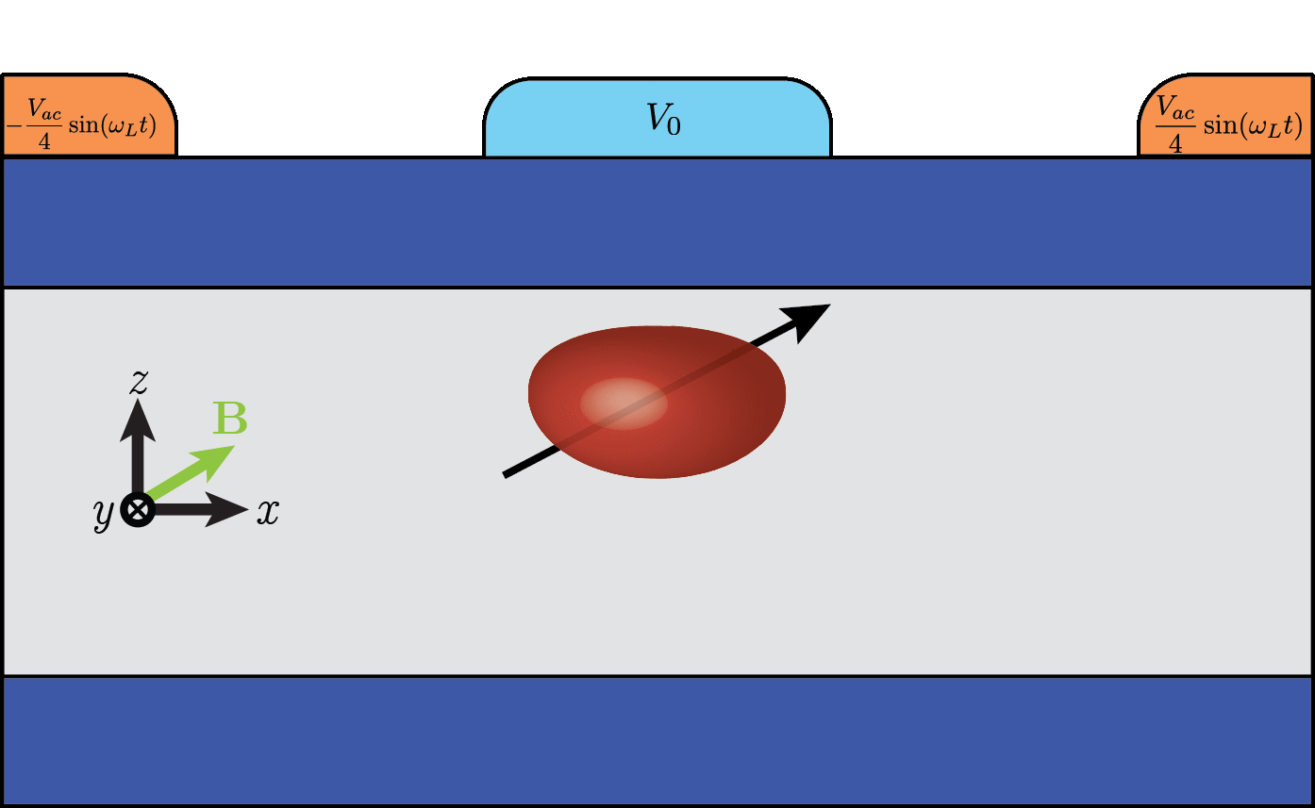
outline
1. Intro: hole spin qubits
2. Manipulation mechanisms
3. spin-photon interactions
4. hybrid super-semi devices with holes
5. conclusion

Slide 3
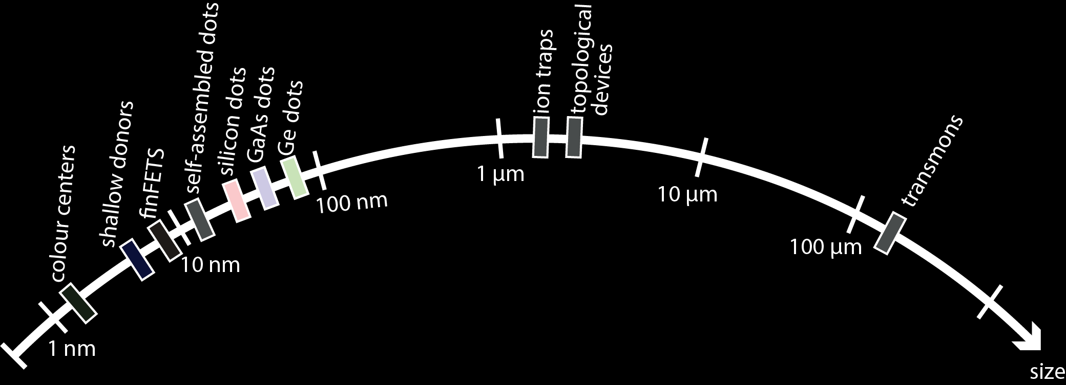
Introduction
From Chatterjee et al., Nature Reviews Physics, 3, 157-177 (2021)
Transmons are leading the race: IBM’s 1121 qubits
Si and Ge QDs are particularly promising for quantum computing purposes

Slide 4
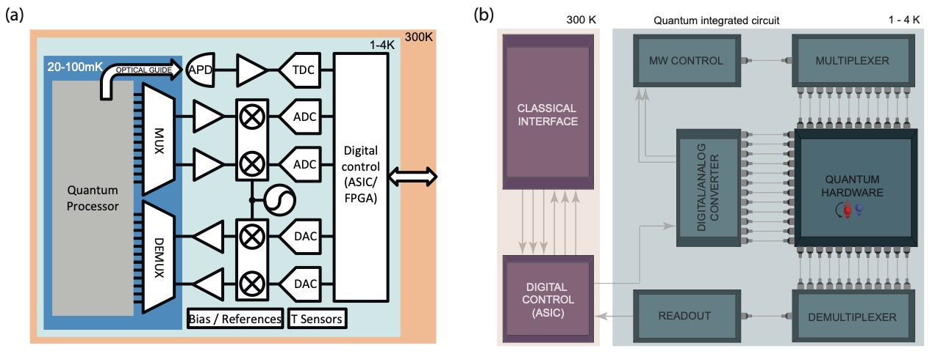
Why semiconductors?
From Chatterjee et al., Nature Reviews Physics, 3, 157-177 (2021)
Industrially compatible
Good coherence times & gate manipulability
Prospects of scalability (small unit cell)
High-temperature operation (4K)
From Petit et al., Nature 580, 355-359 (2020)

Slide 5
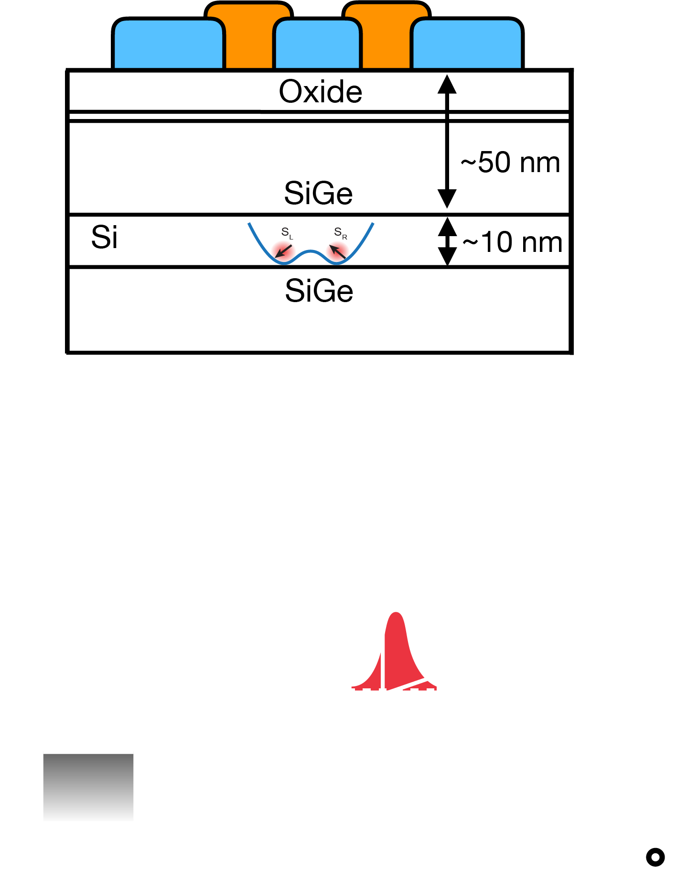
Basic operation of qd qubits
Electrons/holes are confined in a quantum well
The electron/hole is pushed against the interface
Gates are used to manipulate the qubits
Readout: spin-to-charge conversión
Original implementations in GaAs/AlGaAs heterostructures

Slide 6
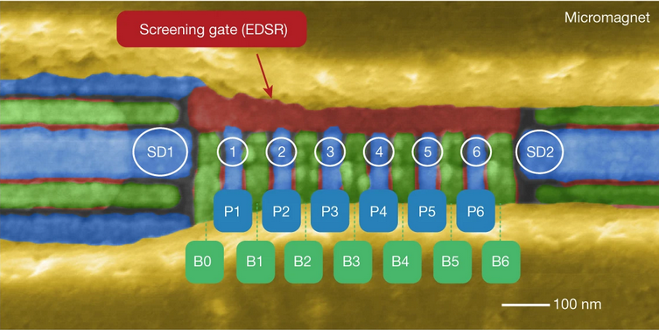
status
-High single-qubit gate fidelities have been demonstrated. See
Nature Nanotechnology 13, 102-106 (2018)
Nature volume 569, pages 532–536 (2019)
Nature Communications volume 11, Article number: 4144 (2020)
-Two-qubit gates beyond QEC threshold. See
Nature 601, 343-347 (2022)
-Working six-qubit processor with electrons
Nature 609, 919–924 (2022)
Nature 591, 580–585 (2021)
12-qubit processor from Intel (not many details yet)
-4K operation demonstrated
Nature 580, 355-359 (2020)

Slide 7
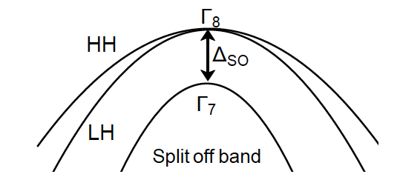
Why hole spin qubits are cool?
High SOC : fast all-electrical manipulation
J=3/2
m_{J}=±3/2
Qubit properties are highly tunable through gate voltages
m_{J}=±1/2
Cool physics: anisotropic g-matrices, Rashba SOC, sweet spots
Partial insensitivity to hyperfine noise

Slide 8
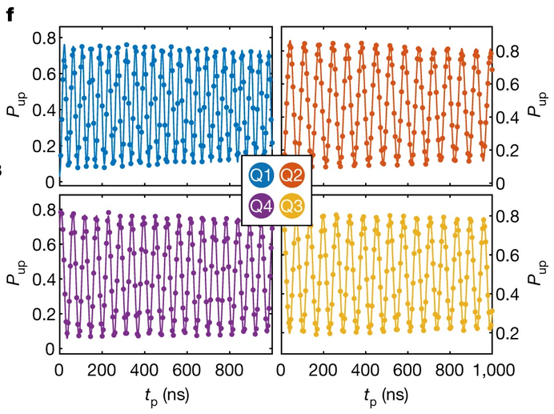
High-Fidelity operation has been achievied
State of the art
4-qubit processor: single-qubit gates above 99.9% and
two-qubit above 99% (Hendrickx et al., Nature 591, 580–585 (2021))
Ongoing experiments with 10 qubit device
Large coherence T₂*~90 μs (Piot et al., Nat. Nano (2022))
“Hot”-qubit operation ~ 4K (Carmenzind et al., Nat. Electronics 5, 178–183 (2022))
Spin-photon coupling of 330 MHz in hybrid Si-cQED system (Yu et al., Nature Nanotechnology (2023))
Hendrickx et al., Nature 591, 580–585 (2021)

Slide 9
2. understanding manipulation mechanisms
-In the experiments the hole is driven laterally, in parallel to an in-plane magnetic field
-We perform simulations on planar dots (isotropic in-plane confinement)
-Hamiltonian of a hole under a magnetic field
Hendrickx et al., Nature 591, 580–585 (2021)
for holes in Ge, g_x ~ g_y ~ 0.05-0.6 g_z ~ 13.5

Slide 10



Thanks to my collaborators
Esteban Rodríguez
Biel Martínez
Yann-Michel Niquet

Slide 11


First suspect: rashba soc
-Lack of inversion symmetry. Determined by geometry and gates
Requires strong fields (hard for Ge/GeSi)
-Nanowire or anisotropic dots (linear Rashba).
See Golovach et al. (2006) PRB 74
$H_{SO} \sim \frac{ℏ}{ml_{so}}p_{x}σ_{y}$
Michal et al., Phys. Rev. B 103, 045305 (2021)
Bosco et al., Phys. Rev. B 104, 115425 (2021)
-Planar isotropic dots (cubic Rashba)
$p_{±}=p_{x}±ip_{y}$
$H_{cubic}=α_{O}p_{−}^{3}σ_{+}+α_{\text{□}}p_{+}p_{−}p_{+}σ_{+}+h.c.$
More effective when magnetic field is vertical B_{z}

Slide 12
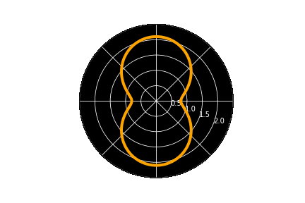
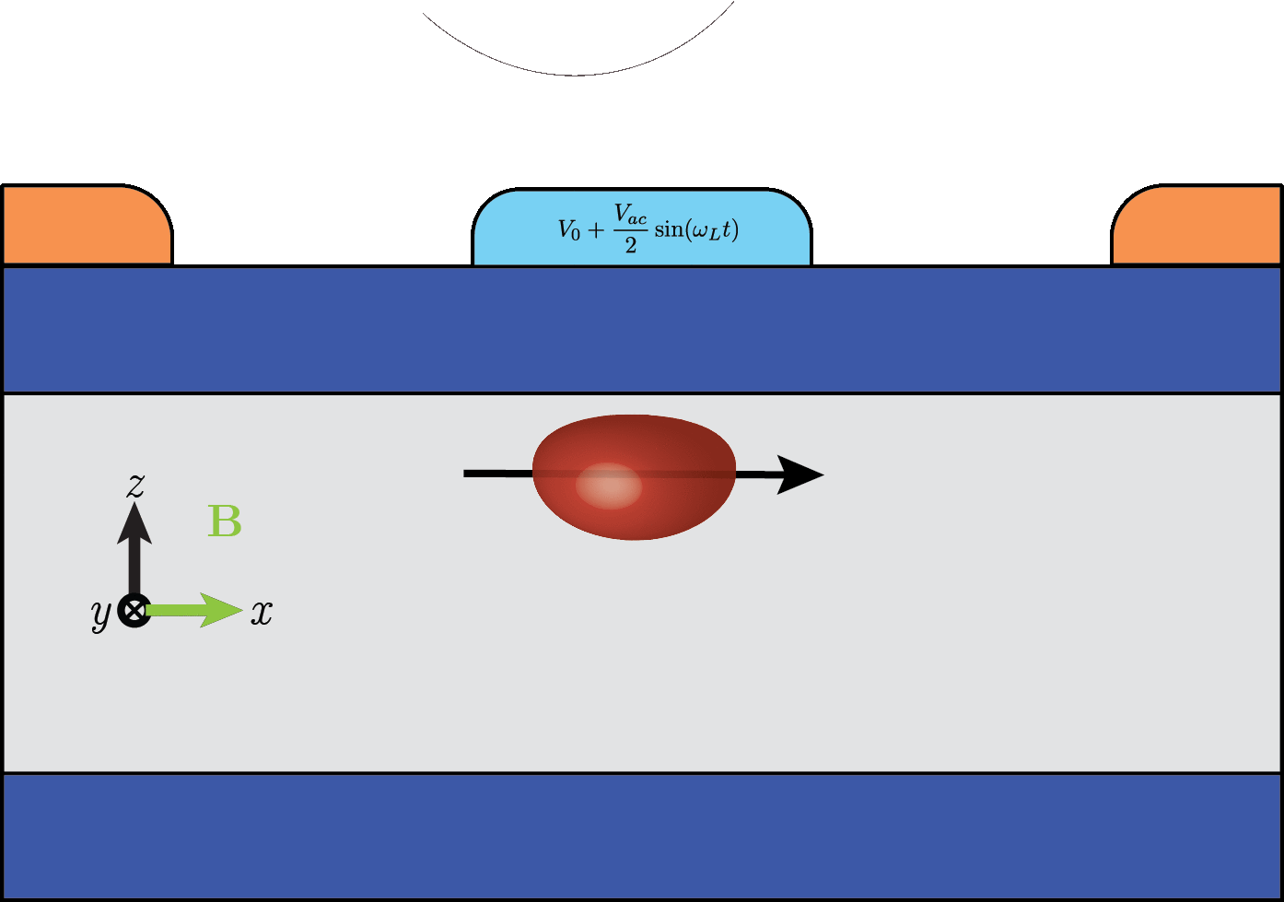
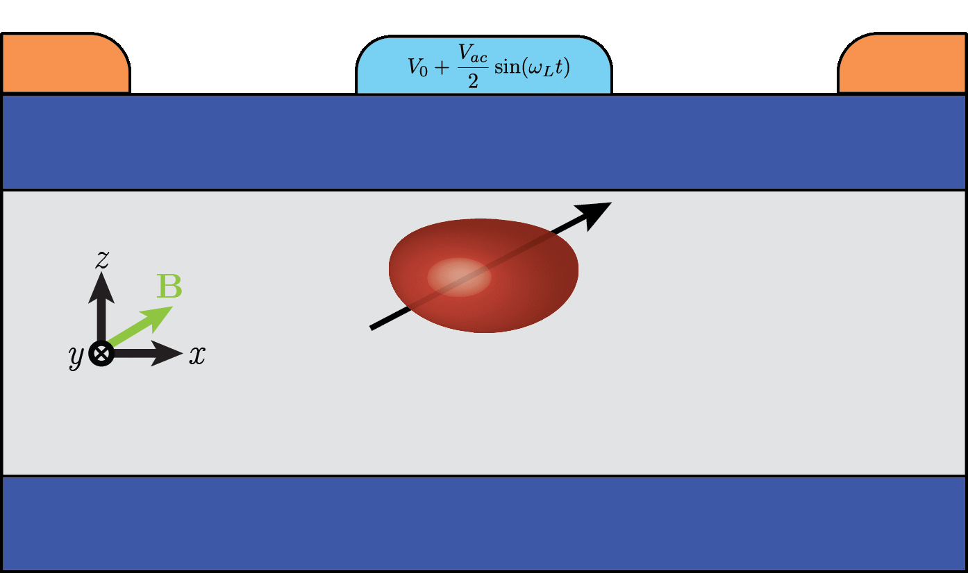

Second suspect: g-tmr
θ_{xz}
-g-factor is anisotropic. By driving g-tensor the hole feels a time-dependent magnetic field
-Deforming the dot with electric fields induces changes in the g-tensor
Effective when
g(V(t))
$$f_{R}=\frac{{μ_{B}BV}_{ac}}{2hg^{∗}}|\left(g⋅b\right)×\left(g^{′}⋅b\right)|$$
Crippa et al. (2018) PRL 120
Kato et al. (2003) Science 229

Slide 13
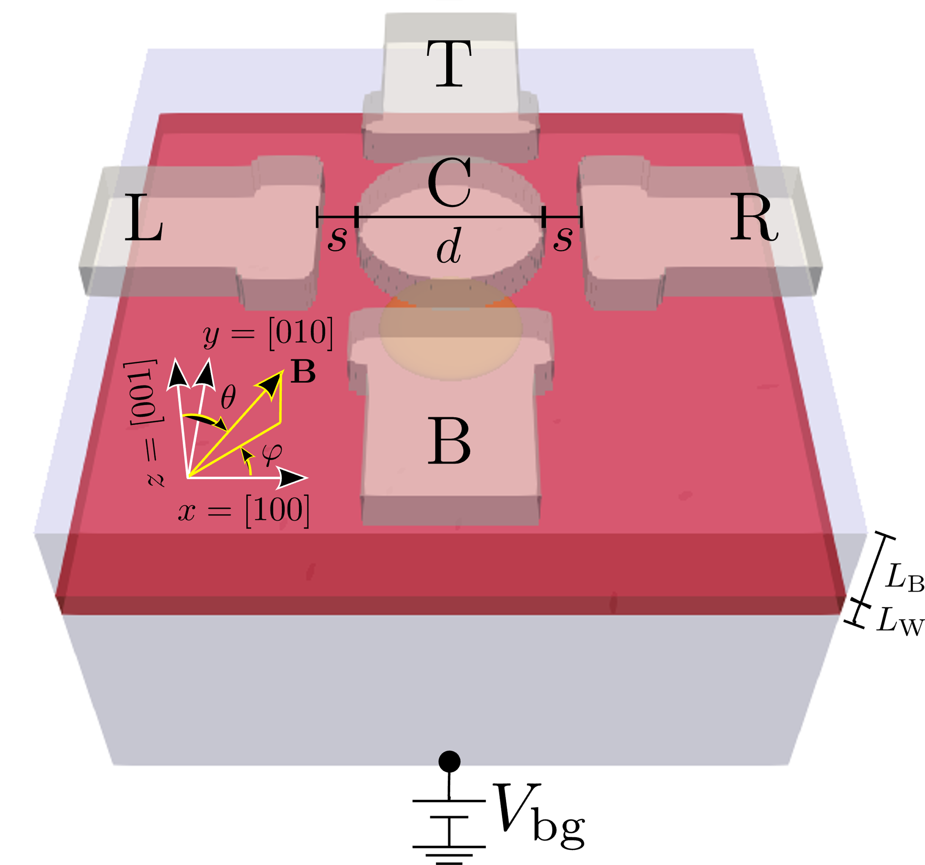
Cubic rashba and gtmr are not fully consistent with experiments
In the experiment, they use in-plane magnetic fields which are inefficient for both cubic Rashba and gTMR
Is there some missing mechanism?
Reviewing some assumptions:
-Separable electric fields
-Homogeneous strain

Slide 14
How we simulate
-Poisson solver for realistic electrostatics as functions of gate voltages
-Numerical solution to Kohn-Luttinger Hamiltonian
-g-matrix formalism to extract Rabi frequencies for given magnetic field orientations

Slide 15

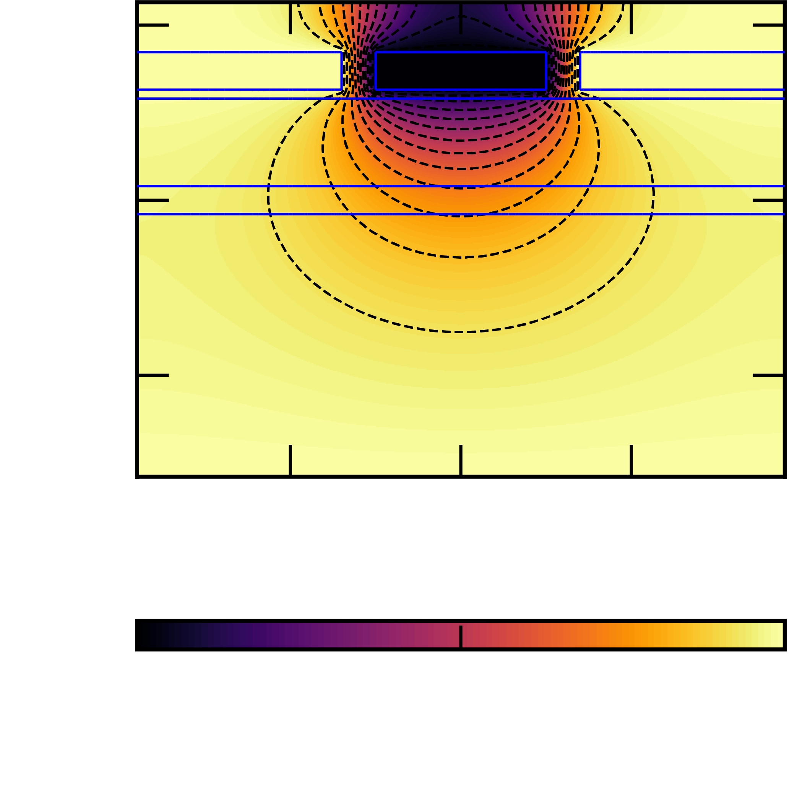
INHOMOGENEOUS & NON-SEPARABLE CONFINEMENT FIELDS
Gates have finite size and are separated a certain distance away from the hole

Slide 16
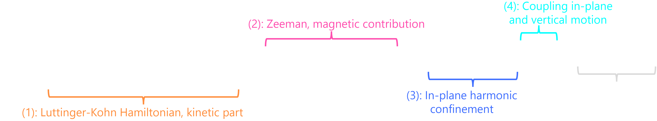

We can capture the physics with a non separable potential
The effective Hamiltonian for GS heavy-hole subspace can be obtained through Schrieffer-Wolff transformation. The subbands couple through
Physically, it is similar to a gTMR mechanism
When the potential is separable $λ_{x,y}=0$

Slide 17
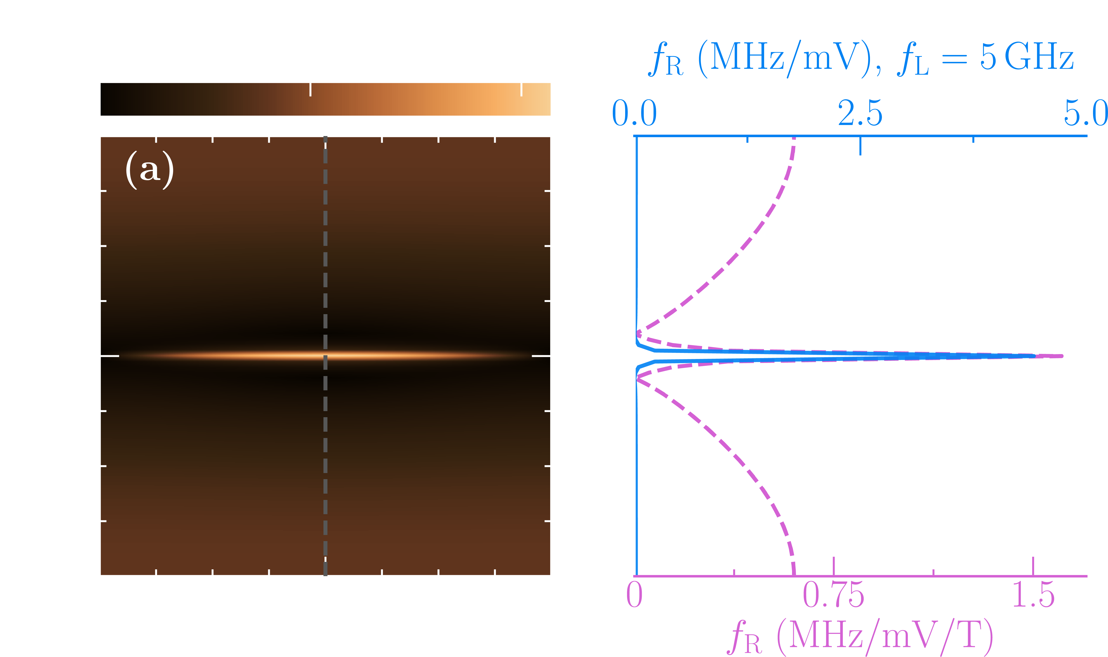
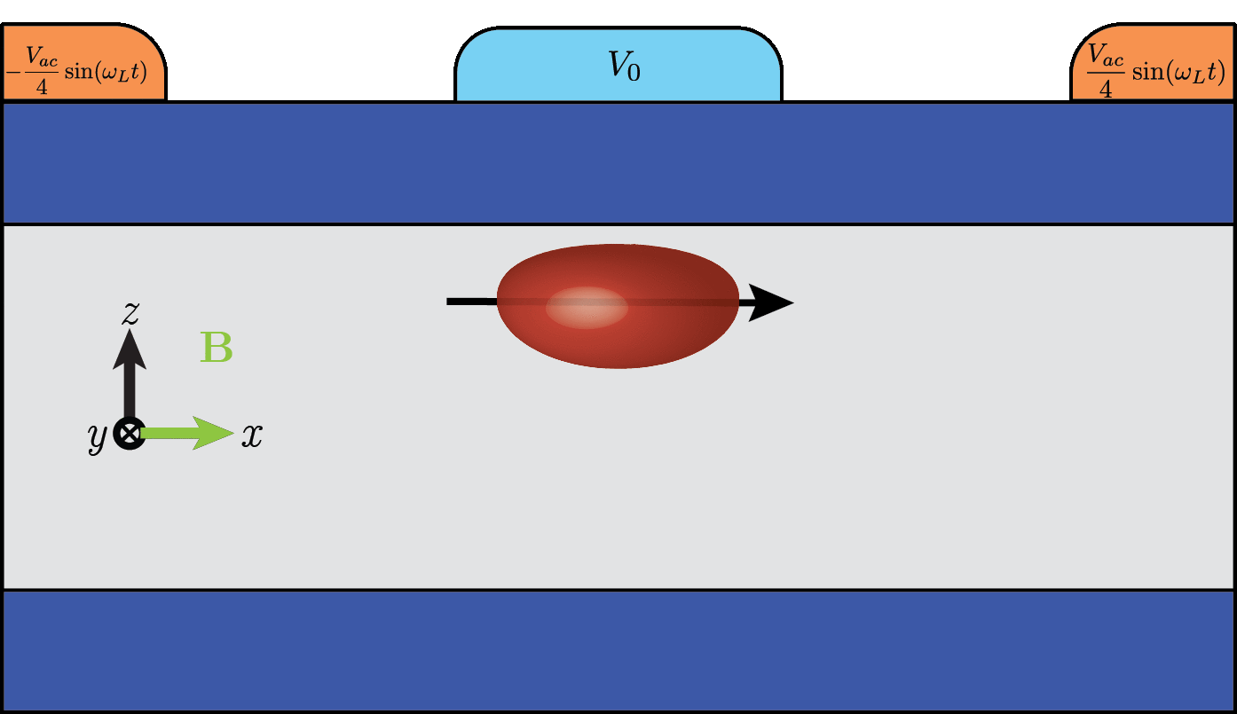
Non-separable field allows in-plane manipulation
z
x
y
Cubic Rashba
Non-separable feature
Still, Rabi frequencies are low. What’s missing?

Slide 18
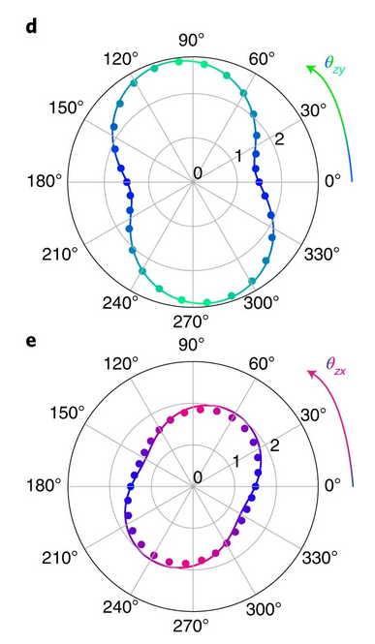
adding INHOMOGENEOUS STRAIn
Experiments had shown rotations in the g-matrix consistent with residual strains
Liles et al., Phys. Rev. B 104, 235303 (2021)
Piot et al., Nat. Nano (2022)
Strain is assumed to be biaxial due to barrier & well lattice mismatch
Device is made with different materials with different expansion coefficients

Slide 19
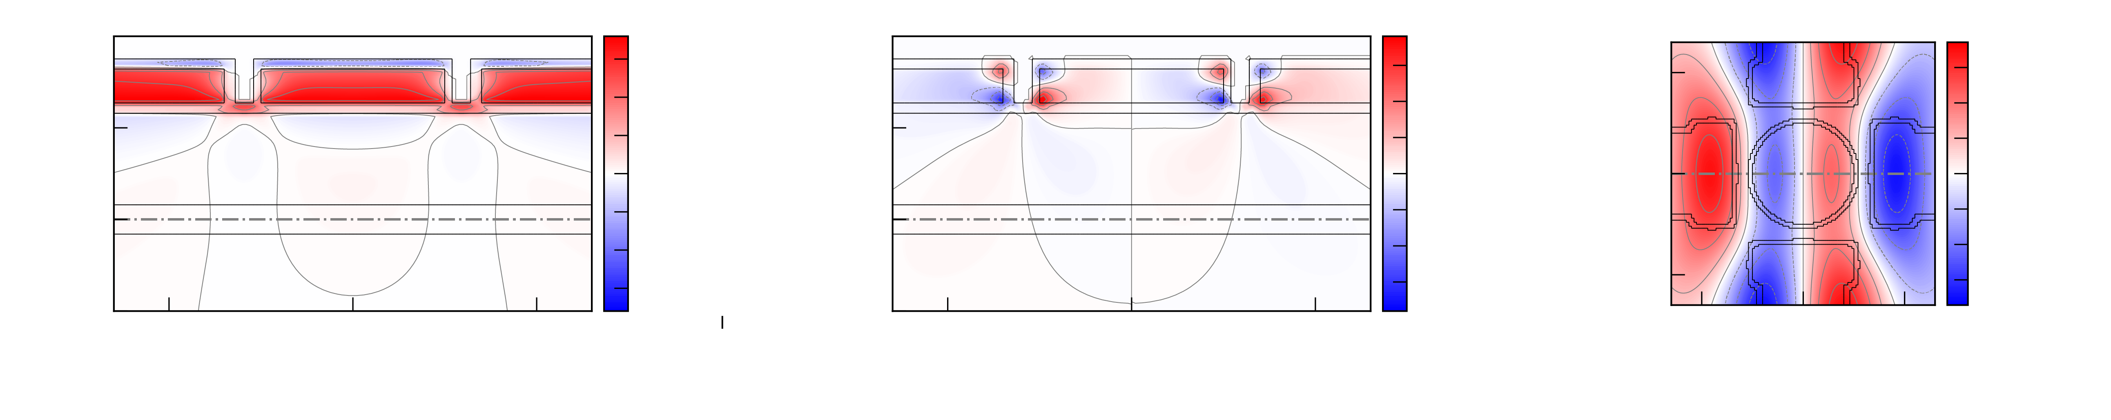
Inhomogeneous strains are ubiquitous
Numerically minimizing the elastic energy density at low T, leads to inhomogeneities commensurate with the gate stack

Slide 20





Inhomogeneous strains induce magnetic gradients
At equilibrium
Strain corrections to g-matrix

Slide 21
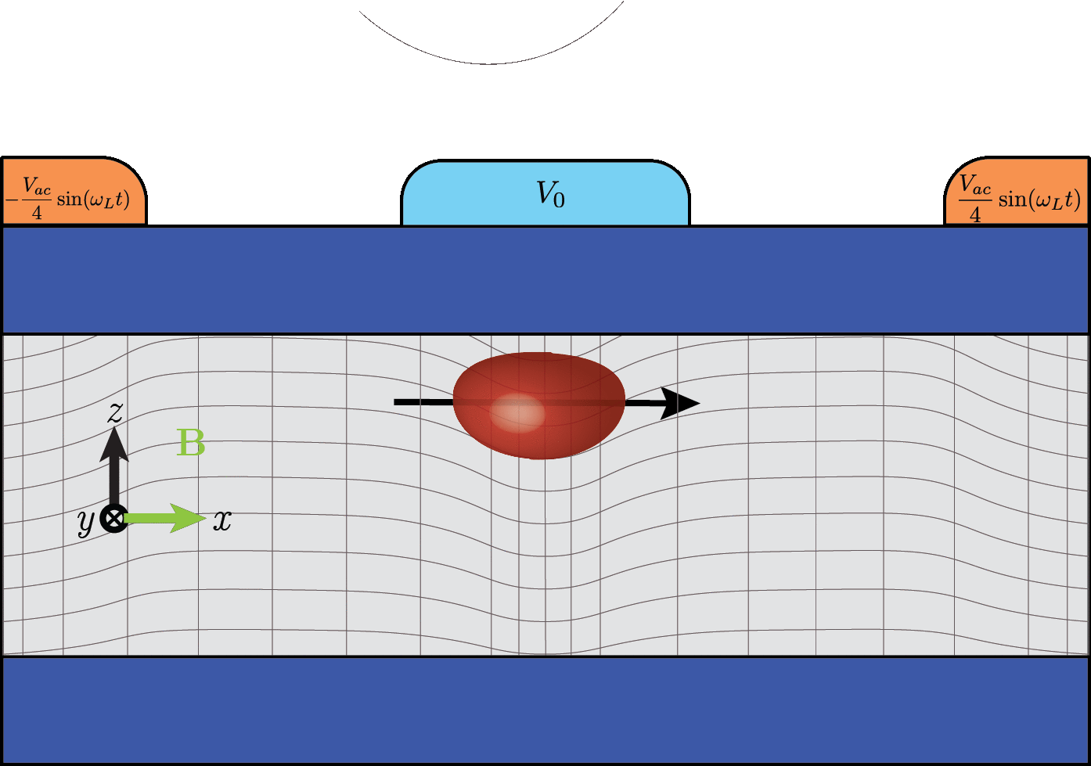
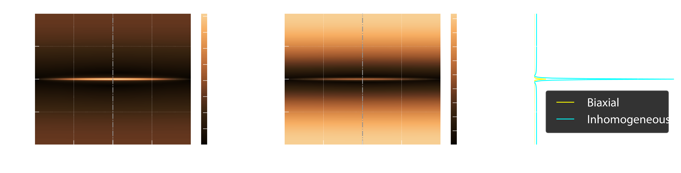

STRAIN INDUCES NEW GTMR AND RASHBA MECHANISMS
z
y
Linearized Rashba
x
Enhanced in-plane feature
Rabi frequencies now are much larger: strain dominates

Slide 22

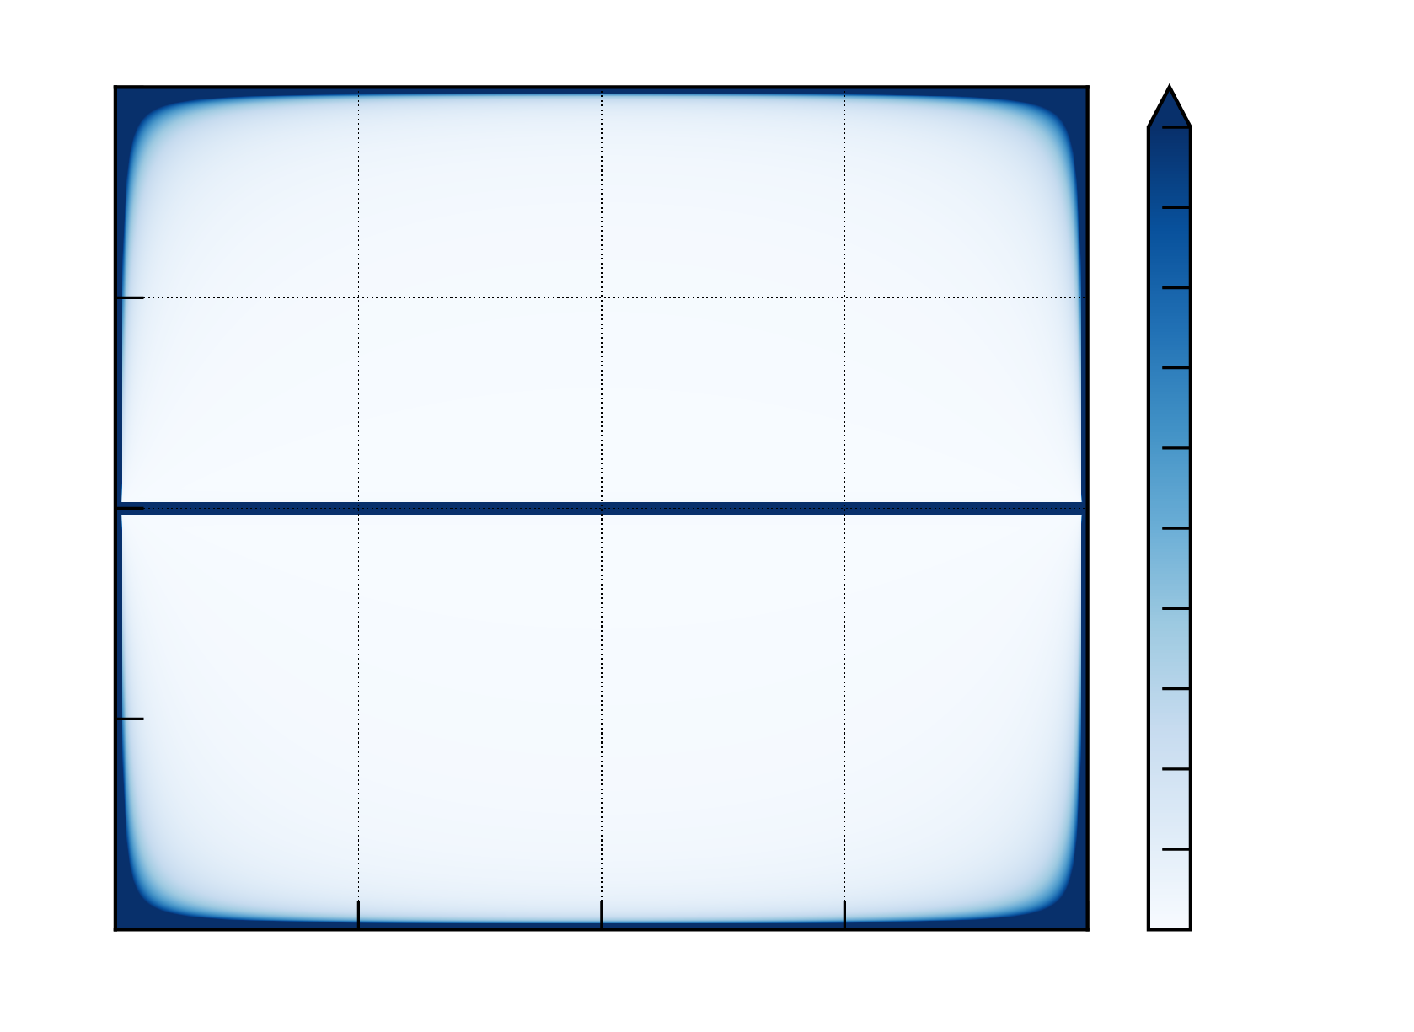
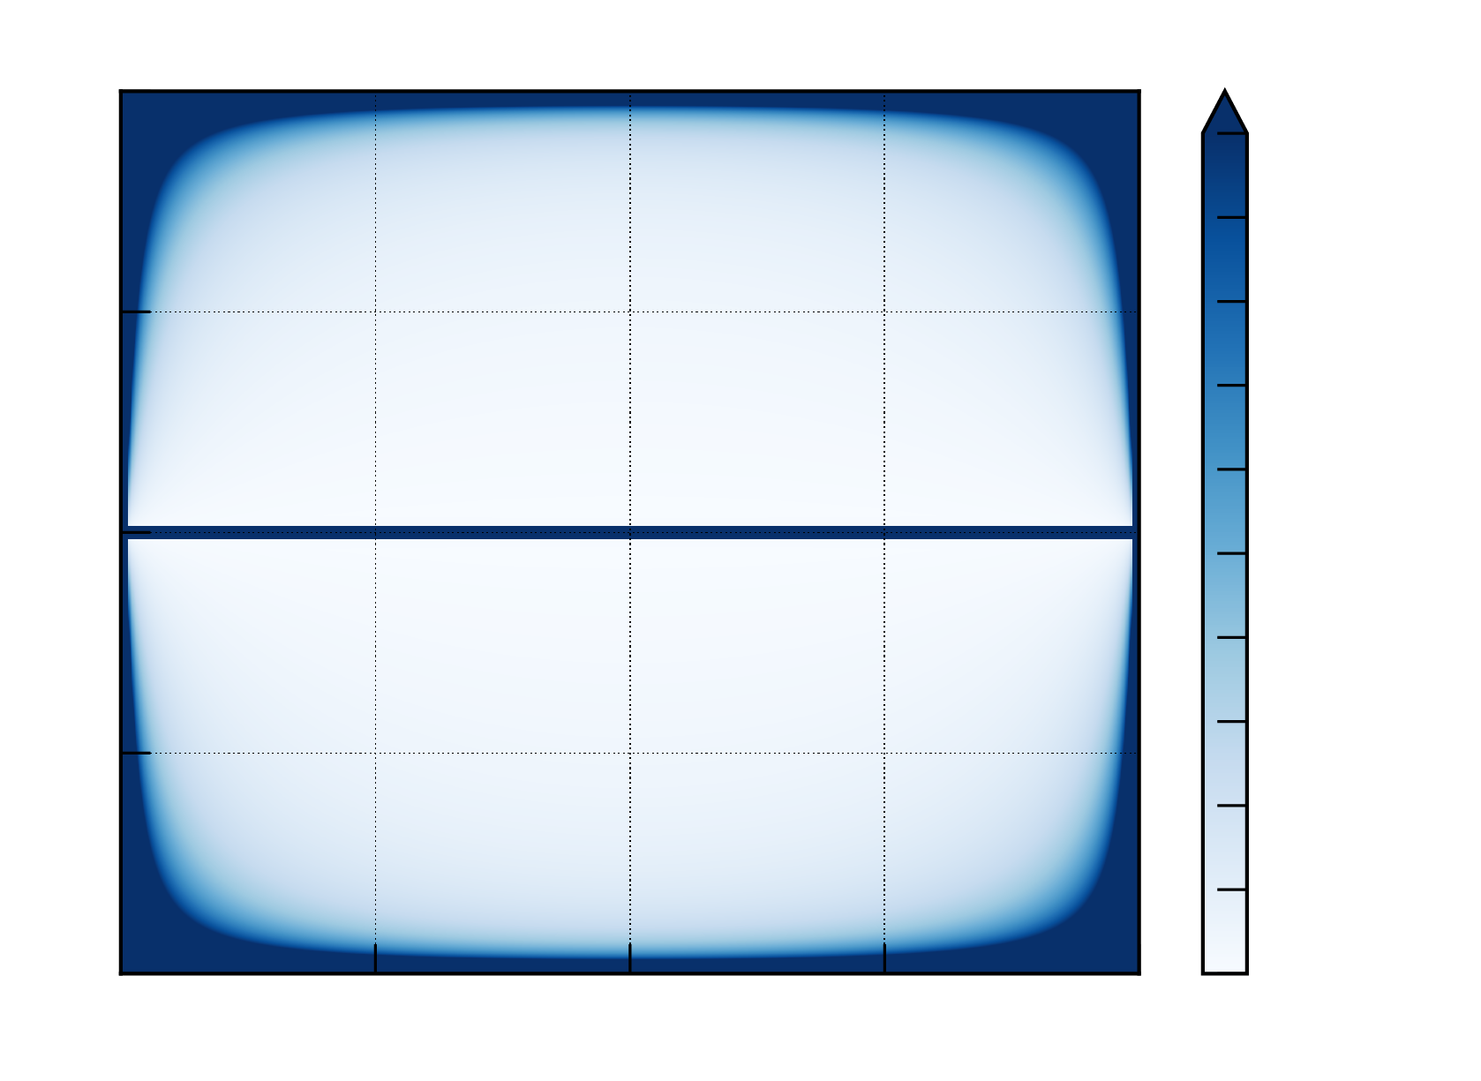
STRAIN slightly improves quality factors
In-plane sweet spot
Out-of-plane quasi-sweet spot

Slide 23
Rabi freq. dependence with thicknesses

Slide 24
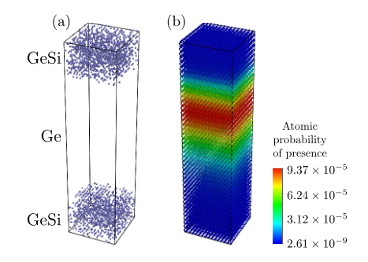
Interfaces also lead to linear rashba and Dresselhaus terms
We perform TB simulations to characterize the spin-splitting of the first HH band in Ge/GeSi heterostructures
The symmetry reduction from O_{h} to C_{2v} leads to allowed Rashba and Dresselhaus terms
Rashba term is related to an interaction between conduction and valence bands

Slide 25

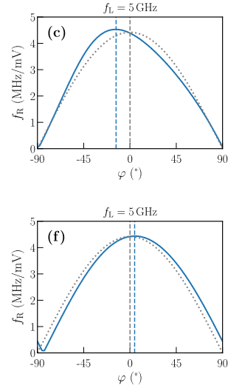

Interface Terms lead to corrections to g-factors and rabi freqs
Ivchenko et al., Phys. Rev. B 54, 5852 (1996)
The Dresselhaus interaction leads to a small in-plane rotation of the g-factors, which in turn skews slightly the Rabi freqs
SW
We note that disordered interfaces tend to kill this effect

Slide 26
Take-home part 1
We found that non-separable field and inhomogeneous strains lead to new manipulation mechanisms
Optimal operation with in-plane magnetic fields for fixed Larmor frequency
Strain-mediated mechanisms dominate hole manipulation

Slide 29
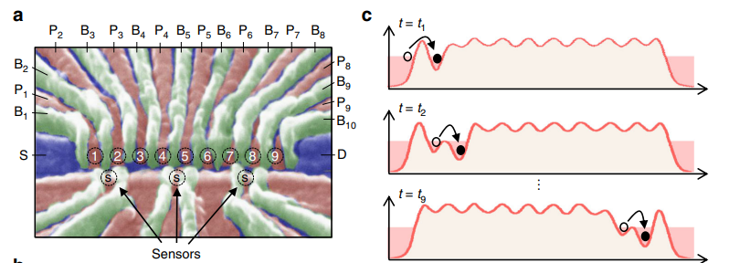
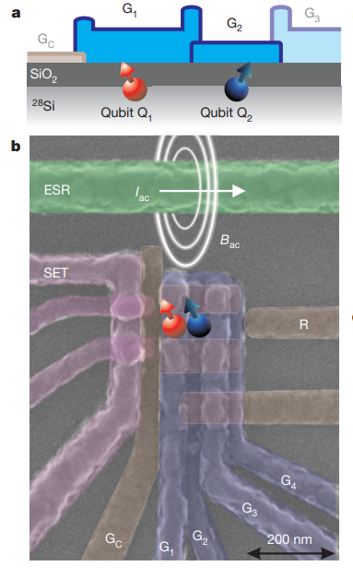
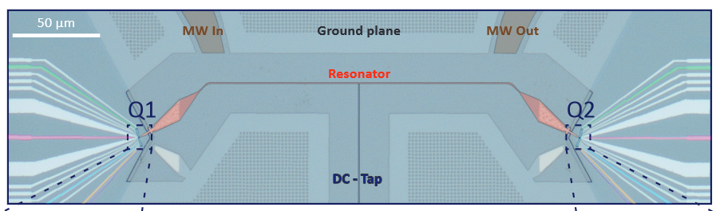
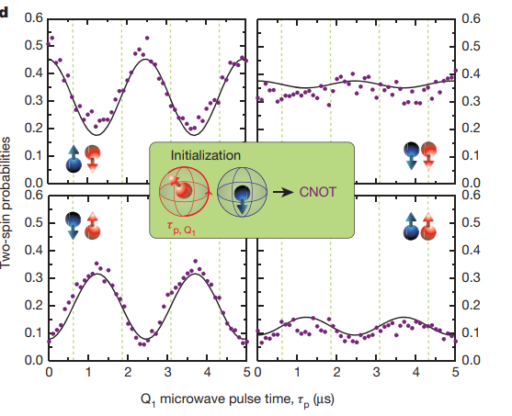
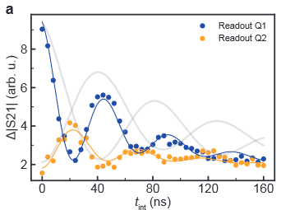
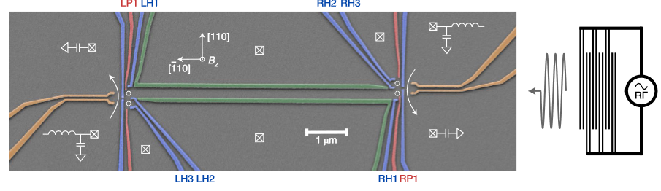



3. Spin-photon coupling
Interaction distance
$$\sim 50nm$$
$$\sim 50nm−50μm$$
$$\sim 1cm$$
Nearest neighbor exchange interaction
Charge shuttling in a QD array
Photon mediated interaction
Mills et al., Nat. Comm. 10 (2019)
Veldhorst et al., Nature 526 (2015)
Jadot et al., Nat. Nano. 16, 570–575 (2021)
Dijkema et al., arXiv: 2310.16805

Slide 30
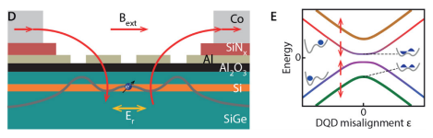
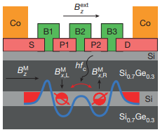
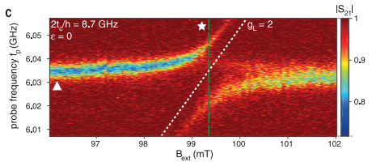
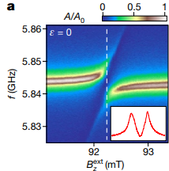
Electron-photon interfaces in Si
Photons couple readily to the charge of the electron
To couple the spin to the photon one needs to induce an artificial SOC: micromagnets
Coupling in the tens MHz
Decoherence rates in few MHz
Samkharadze et al.
Science 359, 1123 (2018)
Mi et al.
Nature 555, 590 (2018)

Slide 31
What if we take advantage of the intrinsic
SOC of holes?
Phys. Rev. B 107, L041303 (2023)
Nature Nano. 18, 741-746 (2023)

Slide 32

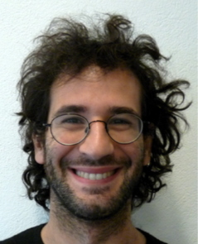



Thanks to my collaborators
Vincent Michal
Michele Filippone
Yann-Michel Niquet
Cecile Yu
Simon Zihlmann
Romain Maurand

Slide 33
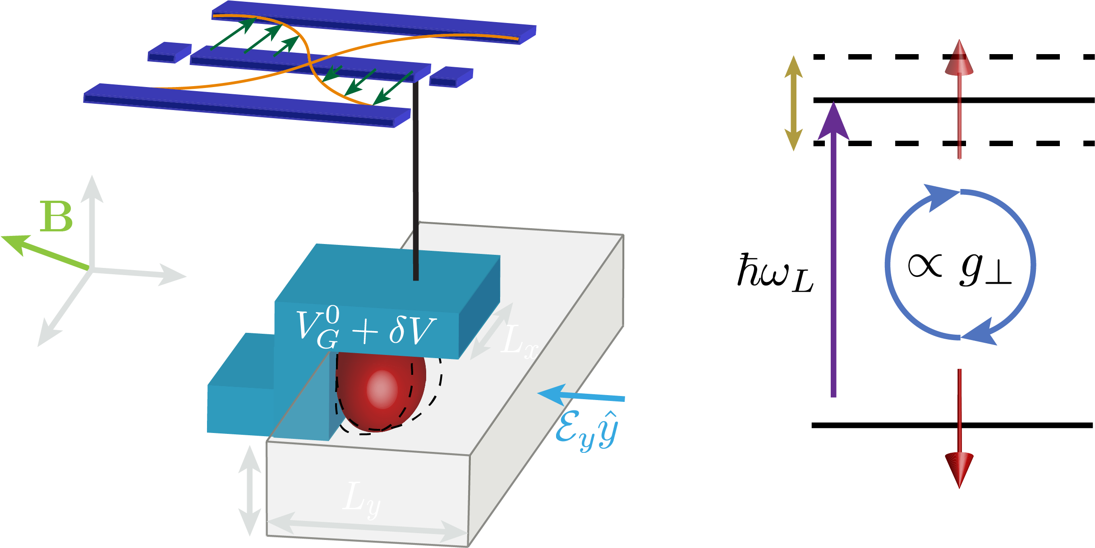
Exploring the minimal setup in si nanowires
-Hole SOC allows minimal setup coupling to
quantized fields
-Thin dot limit with strong y field
-See Bosco PRL 129, 066801 (2022)
for setups based on Rashba driving
Phys. Rev. B 107, L041303 (2023)

Slide 34
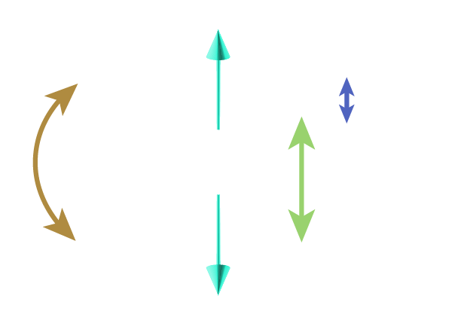



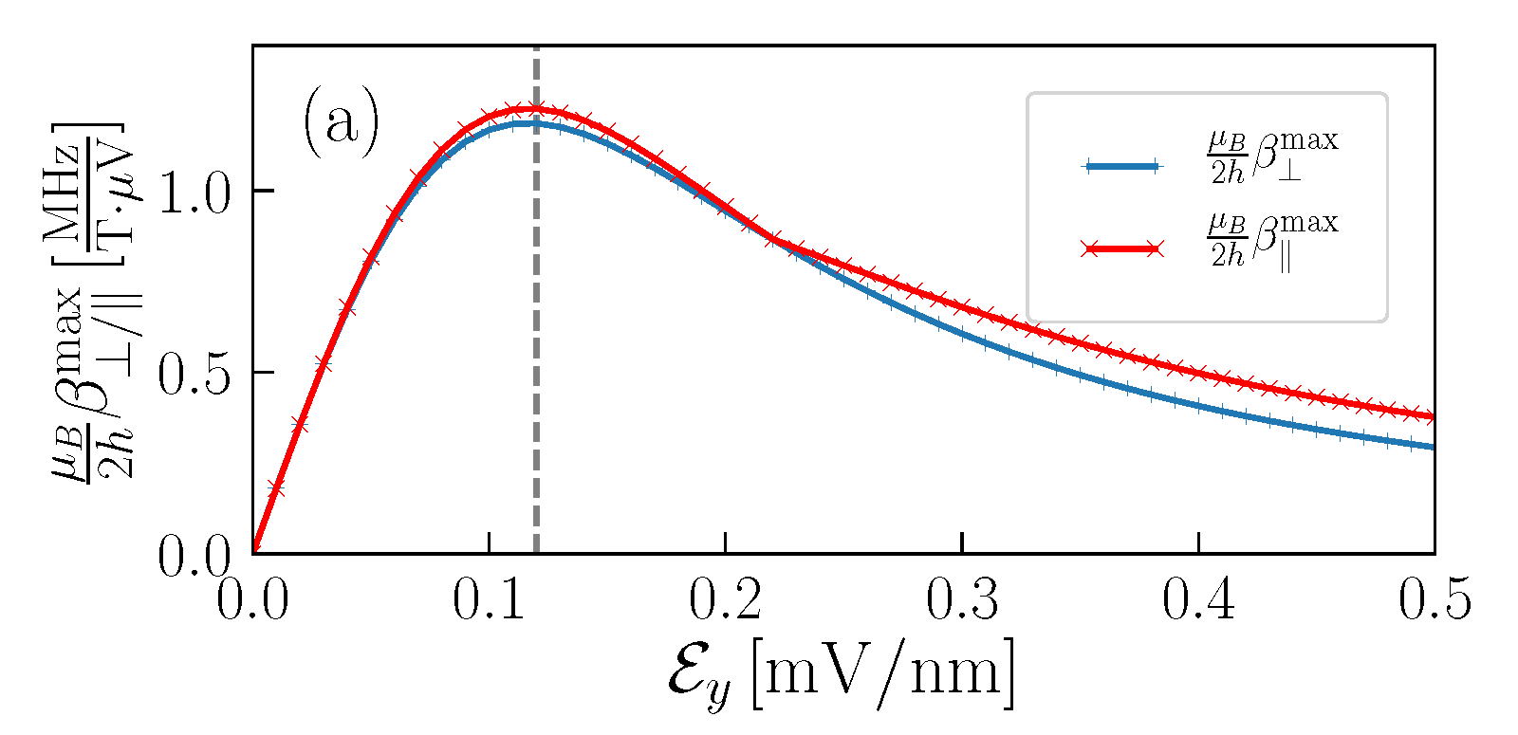


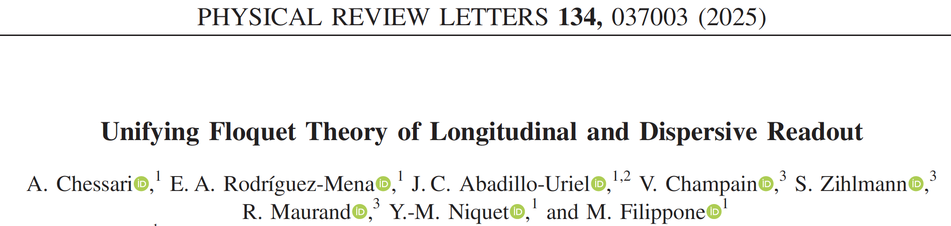
Anisotropic response: transverse and longitudinal
|
|

Slide 35
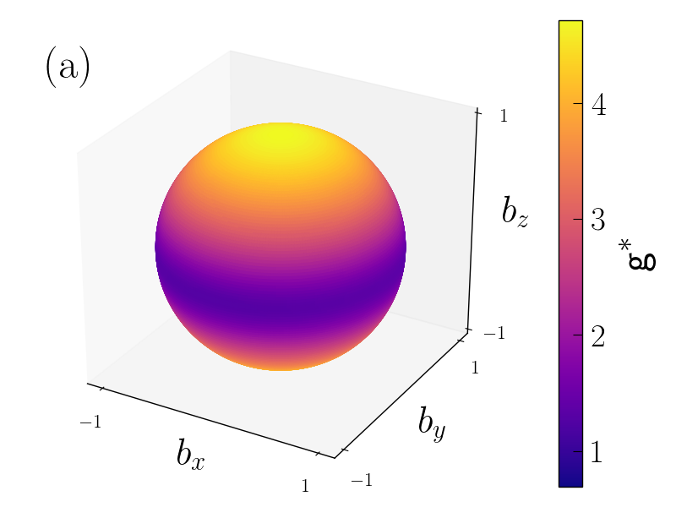
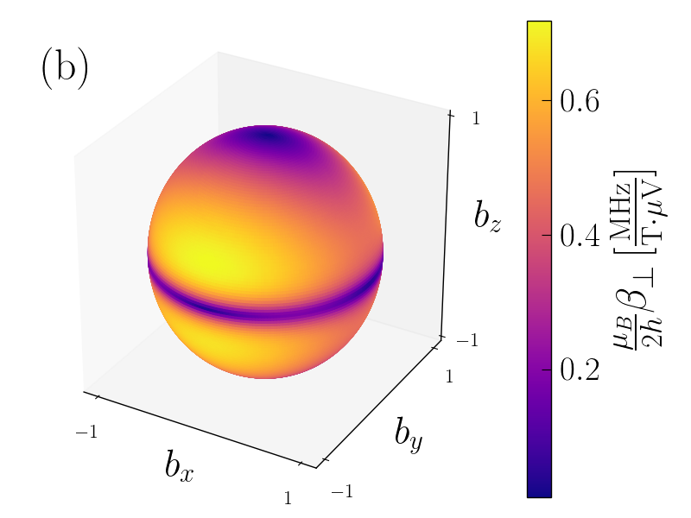
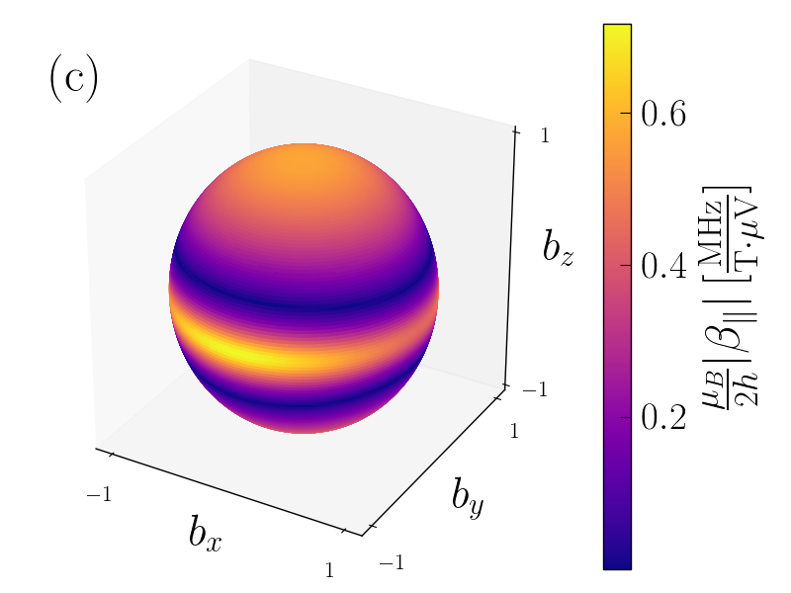
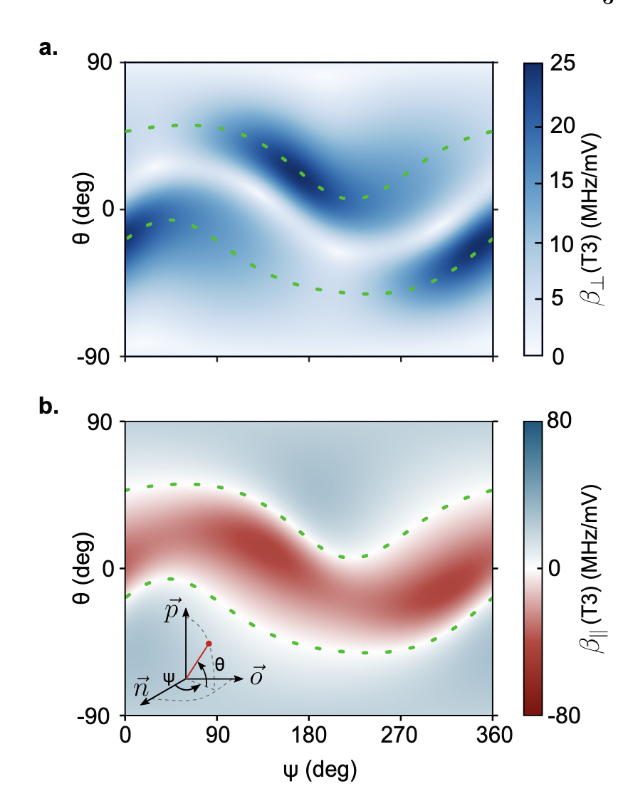
Transverse and longitudinal couplings
Arxiv:2412.13069
Reciprocity between transverse and longitudinal coupling:
Reciprocal sweetness

Slide 36
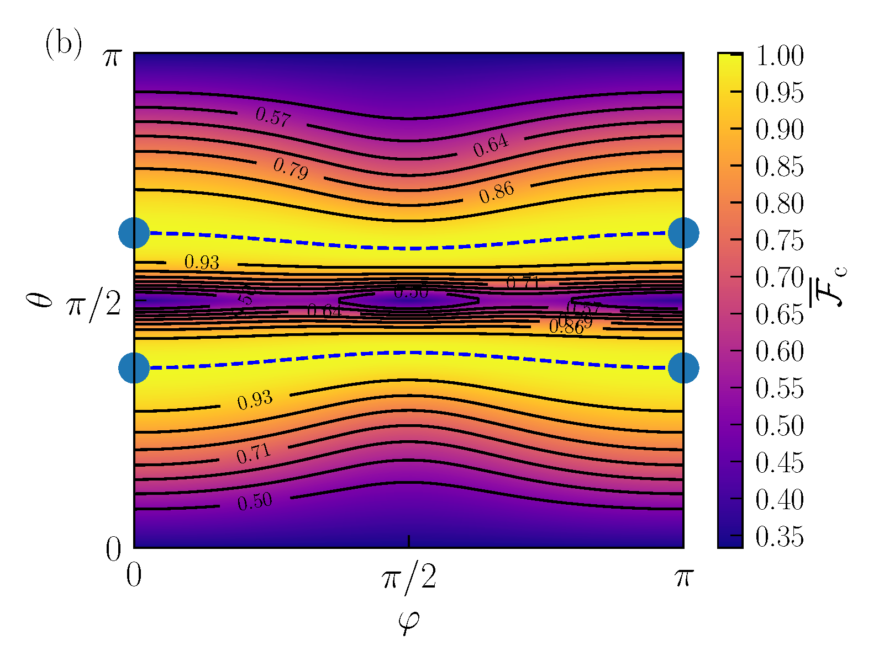



high-fidelity operation is achievable at the ss
Quantum state transfer: exchange between photonic and spin excitations
High-fidelity operation is feasible with longitudinal coupling using curvature driving

Slide 37
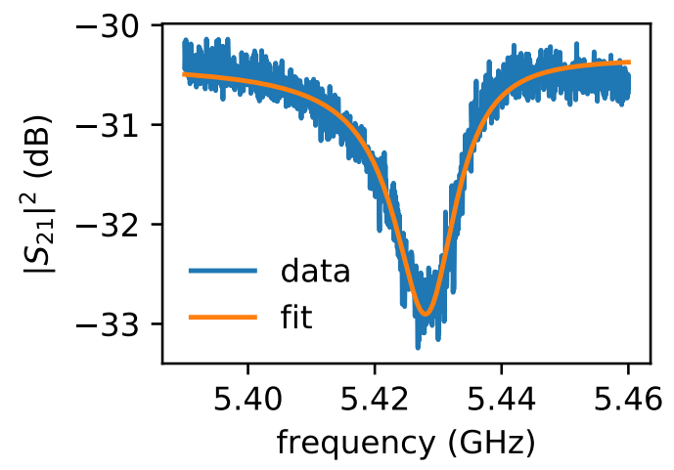
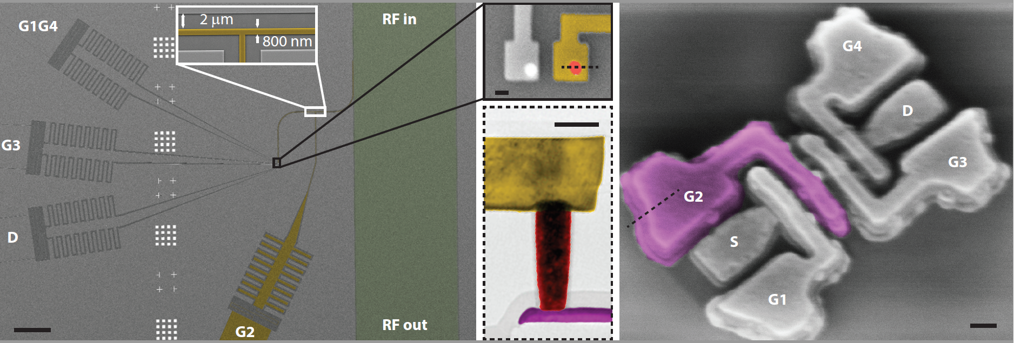


Experiment: Circuit QED with hole spins in Si
$ω_{r}/2π=5.43$ GHz
$κ/2π=$ 13.5 MHz
$κ_{int}/2π=10$ MHz
$κ_{ext}/2π=3.5$ MHz
$λ/2$ NbN CPW resonator $Z_{c}=2 kΩ$, $f_{r}=5.4$GHz
Co-fabrication with resonator at interconnect layer (M1), connected by W vias
Si nanowire transistor on SOI with one gate connected to the resonator
Nature Nano. 18, 741-746 (2023)

Slide 38
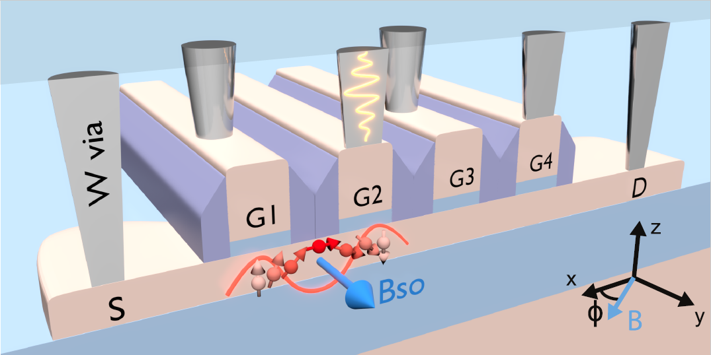
Circuit QED with hole spins in Si
Nature Nano. 18, 741-746 (2023)

Slide 39
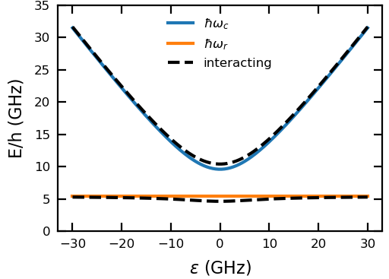
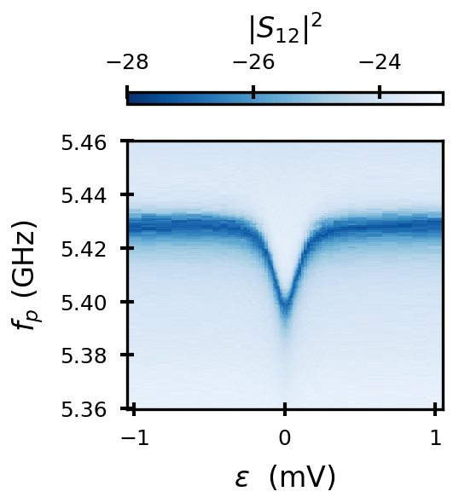
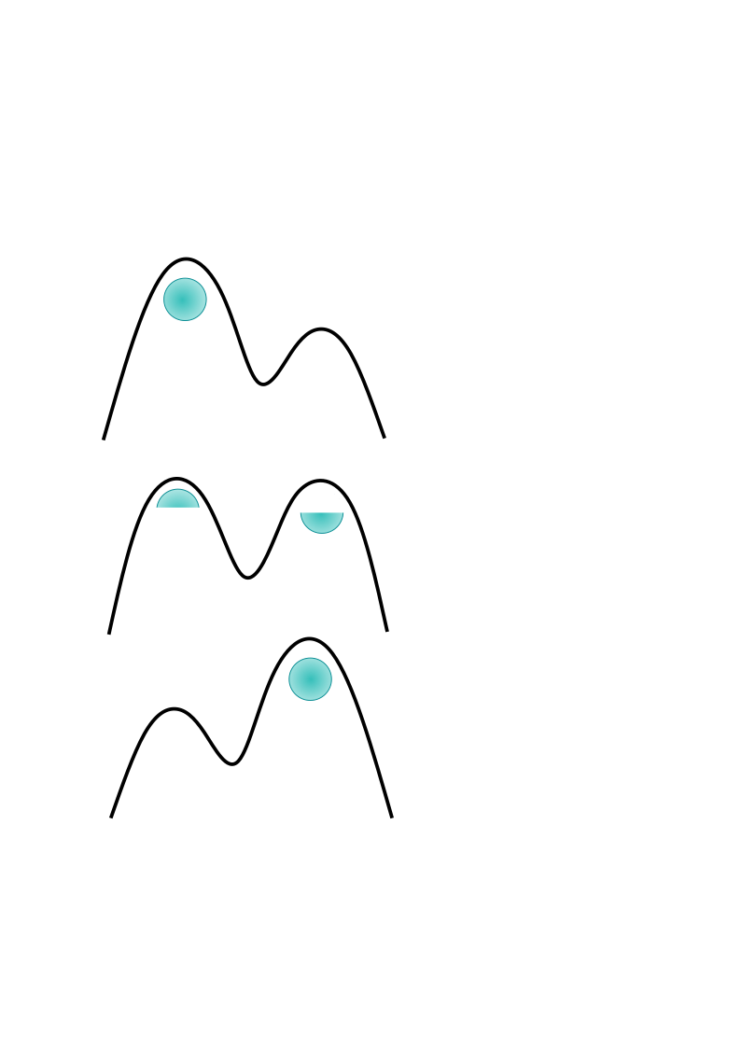

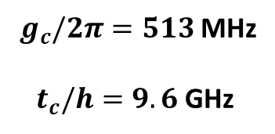
Charge-photon interaction
$$χc$$
Cavity response to a probe field
$g_{c}/2π=513$ MHz
$t_{c}/h=9.6$ GHz

Slide 40



Strong spin-photon coupling
Vacuum Rabi mode splitting
→ signature of strong coupling
Strong spin-photon coupling with ${2g}_{s}/2π=184$ MHz $≫13$MHz

Slide 41
Strong spin-photon coupling: angular dependence
$g_{s}$ heavily depends on the magnetic field orientation

Slide 42

Angular dependence

Slide 43




Strong spin-photon coupling: angular dependence
Max cooperativity
$$C=\frac{4g_{s}^{2}}{γκ}=1600$$
$φ_{max}$ maximizes spin-photon coupling
$$g_{s}∝g_{c}| (\hat{g}⋅\vec{B})×{\vec{B}}_{so}|$$

Slide 44









Interplay between Zeeman and SO field
is the spin-orbit unit vector over which the spin precesses as it moves in x
is the length over which there is a spin flip
z
Tunneling flips the spin
x
Tunneling preserves the spin
y
In our case:

Slide 45






Angular dependence of $g_{L},g_{R},t_{sc}$ and $t_{sf}$
$t_{sc}$ and $t_{sf}$ for anisotropic g-factors
$t_{sc}$ and $t_{sf}$ for averaged g-factors
g-factors

Slide 46


$ε$ vs $B$ –maps: Measurement of $g_{L},g_{R}$ and SOI

Slide 47



Single-dot limit
Michal et al. Phys. Rev. B 107, L041303 (2023)
Bosco et al. PRL 129, 066801 (2022)

Slide 48

Conclusions part 2
Holes offer new opportunities for spin-photon coupling
Si-MOS hole spins embedded in a high-impedance cavity
Si-MOS hole charge bordering ultra-strong charge-photon coupling with $g_{c}=513 MHz$
Unprecedented spin-photon coupling $g_{s}=330$MHz
First demonstration of sizeable coupling in single dot limit $g_{s}≃2$MHz
OUTLOOK
Ultrastrong coupling regime theory and two-photon processes
Multidot effects
Missing effects such as inhomogeneous strains

Slide 49
4. superconducting proximity effect in hole-based Ge hybrid semi-super devices
D. Míchel Pino
Rubén Seoane Souto
María José Calderón
Ramón Aguado
J. C. Abadillo-Uriel
Arxiv:2501.00088

Slide 50

Why Hybrid devices & why Ge?
Semiconductor Spin qubits
Superconducting qubits
Hybrid super-semi devices. Connectivity + gate-tunability Andreev spin qubits, gatemons
InAs Andreev Spin Qubits show limited coherence Pita Vidal et al., Nature Physics 19, 1110-1115 (2023) Hays et al., Science 373, 6553 pp. 430-433
Hays et al., Science 373, 6553 pp. 430-433

Slide 51


Holes as candidates for hybridization
Unusual forms of SOC :
$p_{±}=p_{x}±ip_{y}$
$H_{cubic}=α_{O}p_{−}^{3}σ_{+}+α_{\text{□}}p_{+}p_{−}p_{+}σ_{+}+h.c.$
Strain induced: J.C. Abadillo-Uriel et al., PRL 131, 097002 (2023) Linear Rashba: Michal et al., Phys. Rev. B 103, 045305 (2021)
Bosco et al., Phys. Rev. B 104, 115425 (2021) Inseparable electric effects: B. Martínez, J.C. Abadillo Uriel, et al., PRB 106, 235426 (2022)
Spin qubit properties are gate-tunable
Question is then: what happens if we add superconductivity to the mix?
First super-Ge devices show a large induced gap ~60 μeV Lakic et al., Nat. Materials (2025); Tosato et al., Nat Comms 4 23 (2023); Sagi et al., Nat Comms 15, 6400 (2024).

Slide 52


Comprehensive study of the proximity effect

Slide 53



Effective CB pairing effects into the 4kp model

Slide 54



Full 4kp model for 2DHG

Slide 55




CB PAIRING EFFECTS IN THE RASHBA BASIS (OR KL BASIS)
Analytical effective Hamiltonian in the eigenbasis of the hole subspace:
We get intra- and inter-band effective pairings (k- and spin-dependent)
Minigaps are gate tunable, anisotropic, and k-dependent

Slide 56


HH-lh PAIRING EFFECTS IN THE RASHBA BASIS (OR KL BASIS)
Analytical effective Hamiltonian in the eigenbasis of the hole subspace:
We get intra- and inter-band effective pairings (k- and spin-dependent)
For more negative μ Fermi-level anticrossings occur at higher k

Slide 57



MIXED PAIRING EFFECTS IN THE RASHBA BASIS (OR KL BASIS)
Mixed HH-LH pairing terms are allowed for lower symmetry:
Linear-in-k. Quite anisotropic

Slide 58



PUTTING IT TOGETHER
Mixed HH-LH proximity:
CB proximity:
HH & LH proximity:
HHs
LHs
Minigaps are gate tunable, anisotropic, and k-dependent (quadratic)
For more negative μ Fermi-level anticrossings occur at higher k
Linear-in-k. Quite anisotropic

Slide 59
Induced pairing effects through the bands
CB proximity:
HHs
LHs
Minigaps are gate tunable, anisotropic, and k-dependent (quadratic)

Slide 60
EFFECT of different bands
CB proximity:
HH & LH proximity:
HHs
LHs
Minigaps are gate tunable, anisotropic, and k-dependent (quadratic)
For more negative μ Fermi-level anticrossings occur at higher k

Slide 61

EFFECT of different bands
Mixed HH-LH proximity:
CB proximity:
HH & LH proximity:
HHs
LHs
Minigaps are gate tunable, anisotropic, and k-dependent (quadratic)
For more negative μ Fermi-level anticrossings occur at higher k
Linear-in-k. Quite anisotropic
jc.abadillo.uriel@csic.es

Slide 62
EFFECT of different bands
Mixed HH-LH proximity:
CB proximity:
HH & LH proximity:
HHs
LHs
Minigaps are gate tunable, anisotropic, and k-dependent (quadratic)
For more negative μ Fermi-level anticrossings occur at higher k
Linear-in-k. Quite anisotropic

Slide 63





Vertical Zeeman: f-wave superconductivity
Geometrical competition between the Rashba spin-splitting and the Zeeman field:
DOS estimation:
The gaps closes with vertical field but it makes the transverse component stronger (f-wave)

Slide 64




IN-plane Zeeman: GAP VS PAIRING. BOGOSURFACES
Direct vs geometrical competition between the Rashba spin-splitting and the Zeeman field:
If Larmor vector is parallel to the Rashba splitting, the spectrum gets titled

Slide 65




Rich van hove singularities in dos
Van Hove singularities boil down to minima and maxima in the anisotropic spectral gap

Slide 66



Rich van hove singularities in dos

Slide 67
Take-home part 3:
SuperHoles exhibit some exotic superconducting pairing terms
Experimentally measured gaps seem to be mostly direct but may have small mixed and CB contributions
Gaps are strongly anisotropic and have complex competition with B fields
Experimental signatures in DOS: Bogoliubov bands, van Hove singularities

Slide 68
Conclusions
Holes are interesting creatures with cool physics still being unveiled
New mechanisms for manipulation: inhomogeneous electric fields: Phys. Rev. B 106, 235426 (2022)
inhomogeneous strain: PRL 131, 097002 (2023)
Natural spin-photon coupling: Nature Nano. 18, 741-746 (2023)
Single dot spin-photon architectures are possible: Phys. Rev. B 107, L041303 (2023)
Rich hybrid physics: arxiv:2501.00088

Slide 69



Characterizing the charge-photon coupling
Dispersive shift at $ε=0$
$$χ_{c}=g_{c}^{2}⋅\left(p_{0}−p_{1}\right)⋅\left(\frac{1}{ω_{q}−ω_{r}}+\frac{1}{ω_{q}+ω_{r}}\right)$$
$p_{1}= \frac{1}{1+e^{ℏω_{q}/k_{B}T}}$
$p_{0}=1−p_{1}$
$g_{c}/2π=513$ MHz
$t_{c}/h=9.6$ GHz

